Slide 1


Chapter 8: Advanced IUS Techniques for IBD Management
v1.0, 10 December 2022 | EM-121011
For Healthcare Professionals only
Developed under the mentorship of the Asian Organization for Crohn's & Colitis
Supported by Janssen Asia Pacific, a division of Johnson and Johnson International (Singapore) Pte. Ltd. Editorial development by Transform Medical Communications, New Zealand
© Janssen Asia Pacific, a division of Johnson & Johnson International (Singapore) Pte. Ltd.

Slide 2
About IUS Primer module
IUS Primer module was created for training gastroenterologists in Asia on adopting Intestinal Ultrasound (IUS) for the diagnosis and management of Inflammatory Bowel Disease
Transform Medical Communications was commissioned by Janssen Asia Pacific for the development of this educational module under the guidance of IUS Primer working group members and AOCC. The division of Janssen responsible for developing the module is from medical education that follows strict non-promotional and educational guidance.
The development of the module was funded by Janssen Asia Pacific, a division of Johnson and Johnson International (Singapore) Pte. Ltd. in 2022. Non-commercial use of this module is permitted without any further permission, provided credit for the content is clearly attributed to Janssen Asia Pacific.
AOCC: Asian Organization for Crohn's & Colitis; IUS: Intestinal ultrasound.

Slide 3
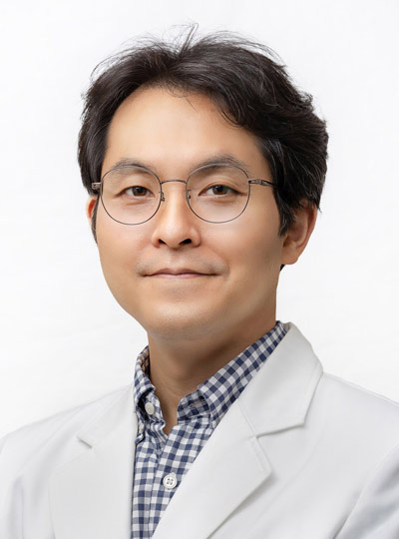
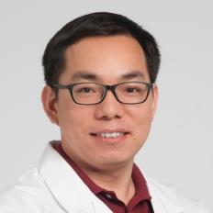
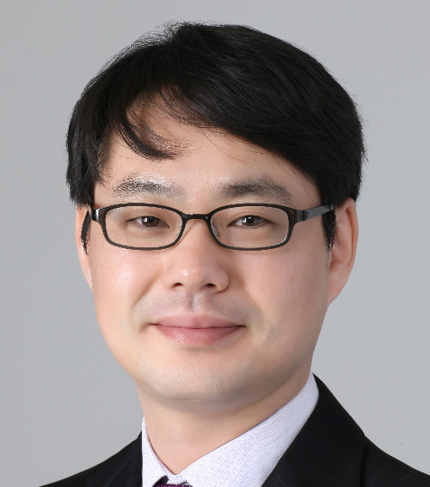

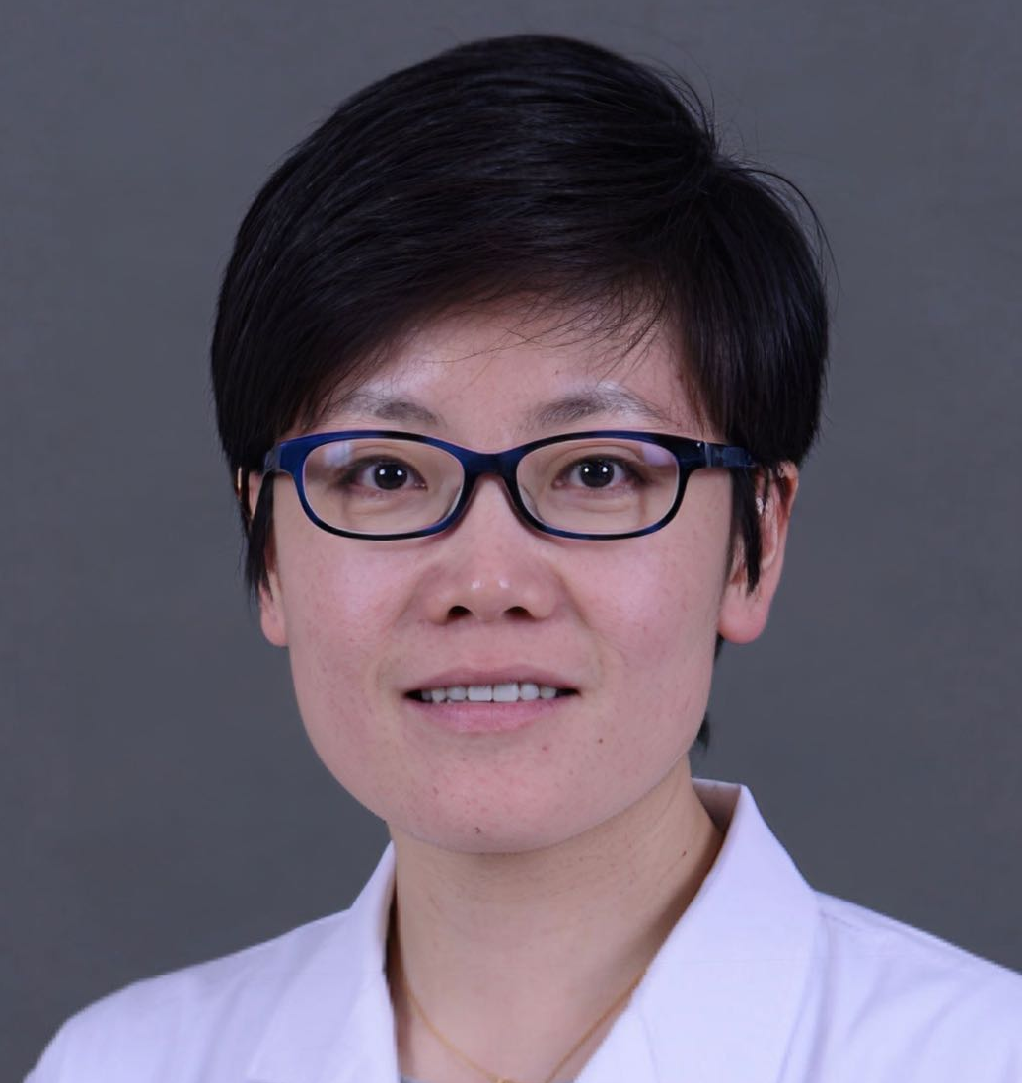
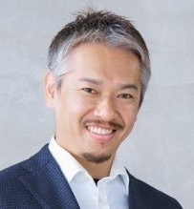

Special thanks to IUS Primer AOCC working group members
Prof. Eun Soo KIM
A/Prof. Ren MAO
Kyungpook National University
First Affiliated Hospital of Sun Yat-sen University
KOREA
CHINA
Prof. Chang Kyun LEE
A/Prof. Jun MIYOSHI
Kyung Hee University
Kyorin University
KOREA
JAPAN
Prof. Yue LI
Dr. Shintaro SAGAMI
Peking Union Medical College Hospital
Kitasato University Kitasato Institute Hospital
CHINA
JAPAN
AOCC: Asian Organization for Crohn's & Colitis; IUS: Intestinal ultrasound; WG: working group.

Slide 4
Learning Objectives
Understand the role of advanced techniques – CEUS, SICUS, elastography, and TPUS in IBD management
Explore the validated role of SICUS for assessing postoperative recurrence of CD
1
2
CEUS: contrast-enhanced ultrasound; SICUS: small intestine contrast ultrasonography; IBD: inflammatory bowel disease; IUS: Intestinal ultrasound; TPUS: transperineal ultrasound; WG: working group
Notes:
Key references
Stenczel ND, Purcarea MR, Tribus LC, Oniga GH. The role of the intestinal ultrasound in Crohn's disease diagnosis and monitoring. J Med Life. 2021;14(3):310-315. https://www.ncbi.nlm.nih.gov/pmc/articles/PMC8321617/
Frias-Gomes C, Torres J, Palmela C: Intestinal Ultrasound in Inflammatory Bowel Disease: A Valuable and Increasingly Important Tool. GE Port J Gastroenterol 2021. https://www.karger.com/Article/FullText/520212
Novak KL, Nylund K, Maaser C, et al. Expert Consensus on Optimal Acquisition and Development of the International Bowel Ultrasound Segmental Activity Score [IBUS-SAS]: A Reliability and Inter-rater Variability Study on Intestinal Ultrasonography in Crohn’s Disease. J Crohns Colitis. 2021;15(4):609-616. https://pubmed.ncbi.nlm.nih.gov/33098642/

Slide 5



Role of Contrast-Enhanced Ultrasonography (CEUS)
CEUS involves the administration of IV contrast agents (bolus injection of stabilised microbubbles with gaseous content) that allows real-time visualisation of the small bowel microvasculature.¹
Clinical utility of CEUS in management of CD
To differentiate inflammatory and fibrotic strictures- inflammatory strictures are associated with loss of stratification and the presence of hyperemia on CEUS.¹
Delimitation of fluid cavities helps to differentiate between abscess and inflammatory masses and helps in percutaneous drainage.^{1,2}
Image reproduced from Medellin A, Merrill C & Wilson SR (2018) Abdom Radiol . 43:918–933. (Attribution 4.0 International (CC BY 4.0).
https://creativecommons.org/licenses/by/4.0/legalcode
CEUS shows peripheral enhancement of the mass with a central avascular component suggesting pus, consistent with an abscess cavity.³
Detecting post-operative recurrence: higher concordance between CEUS and colonoscopy compared to IUS alone (p < 0.001).²
CEUS can be used to separate vascular from avascular intestinal/ peri-intestinal lesions including abscesses.⁴
CEUS: contrast-enhanced ultrasonography; IV: intravenous; CD: Crohn’s disease; POR: postoperative recurrence; IUS: intestinal ultrasound
1. Jauregui-Amezaga, A., & Rimola, J. (2021). Life (Basel, Switzerland), 11(7), 603. 2. Frias-Gomes, C., Torres, J., & Palmela, C. (2022). GE-Portuguese Journal of Gastroenterology, 29(4), 223-239. 3. Medellin, A., Merrill, C., & Wilson, S. R. (2018). Abdominal Radiology, 43(4), 918-933. 4. Nylund, K. (2017). Ultraschall in der Medizin (Stuttgart, Germany : 1980), 38(3), e1–e15.
Notes:
Jauregui-Amezaga, A., & Rimola, J. (2021). Life (Basel, Switzerland), 11(7), 603.
Frias-Gomes, C., Torres, J., & Palmela, C. (2022). GE-Portuguese Journal of Gastroenterology, 29(4), 223-239.
Medellin, A., Merrill, C., & Wilson, S. R. (2018). Abdominal Radiology, 43(4), 918-933.

Slide 6



Role of Small Intestine Contrast Ultrasonography (SICUS)
SICUS involves the administration of an oral contrast agent such as PEG solution; ~30–40 min before the examination.¹
Pros: better visualization of the small bowel loops filled with oral contrast increases the localisation, extension, and detection of strictures and penetrating complications.¹
Cons: time-consuming ¹
Clinical utility of SICUS in management of CD
SICUS has higher sensitivity for detecting strictures when compared to IUS (89–94 vs. 74–76%).²
Shows a good accuracy in detecting ileal stenosis and prestenotic dilation.²
Non-invasive alternative technique to assess small bowel lesions and monitor CD extent changes over time.³
SICUS: small intestine contrast ultrasonography; PEG: polyethylene glycol; CD: Crohn’s disease; IUS, intestinal ultrasound
1. Jauregui-Amezaga, A., & Rimola, J. (2021). Life (Basel, Switzerland), 11(7), 603. 2. Frias-Gomes, C., Torres, J., & Palmela, C. (2022). GE-Portuguese Journal of Gastroenterology, 29(4), 223-239. 3. Calabrese, E., et al. (2016) Inflammatory bowel diseases, 22(5), 1168-1183.
Notes:
Jauregui-Amezaga, A., & Rimola, J. (2021). Life (Basel, Switzerland), 11(7), 603.
Frias-Gomes, C., Torres, J., & Palmela, C. (2022). GE-Portuguese Journal of Gastroenterology, 29(4), 223-239.
Calabrese, E., et al. (2016) Inflammatory bowel diseases, 22(5), 1168-1183.

Slide 7




Recommendations for basic techniques for SICUS
Recommended contrast agents include but are not limited to mannitol, sorbitol, lactulose and PEG.
The optimal volume of the oral contrast agent should be less than 500 ml.
The ingestion time for the oral contrast should be 45 minutes.
Laxative bowel preparation administration and spasmolytic agents are not recommended.
SICUS: small intestine contrast ultrasonography; PEG: polyethylene glycol
Taylor, S. (2017). European radiology, 27(6), 2570–2582.
Notes:
PEG: polyethylene glycol
Taylor, S. A., Avni, F., Cronin, C. G., Hoeffel, C., Kim, S. H., Laghi, A., Napolitano, M., Petit, P., Rimola, J., Tolan, D. J., Torkzad, M. R., Zappa, M., Bhatnagar, G., Puylaert, C., & Stoker, J. (2017). The first joint ESGAR/ ESPR consensus statement on the technical performance of cross-sectional small bowel and colonic imaging. European radiology, 27(6), 2570–2582. https://doi.org/10.1007/s00330-016-4615-9

Slide 8

Role of SICUS for assessment of post-operative recurrence in CD
Clinical utility of SICUS in management of CD
Non-invasive alternatives for assessing POR¹
Gold standard for assessing POR¹
SICUS is superior to standard IUS examination for detecting POR with an overall accuracy of 92%.¹
Ileocoloscopy
SICUS has a higher sensitivity (99 vs 82%), but lower specificity (74 vs. 88%) than IUS.²
Fecal calprotectin
IUS
MRE
Small bowel capsule endoscopy
IUS parameters to predict POR¹
Good correlation of SICUS with endoscopic findings after ileocolonic resection.³
BWT
Increased vascularization
CEUS: contrast-enhanced ultrasonography; IV: intravenous; CD: Crohn’s disease; POR: postoperative recurrence; IUS: intestinal ultrasound
1. Jauregui-Amezaga, A., & Rimola, J. (2021). Life (Basel, Switzerland), 11(7), 603. 2. Frias-Gomes, C., Torres, J., & Palmela, C. (2022). GE-Portuguese Journal of Gastroenterology, 29(4), 223-239. 3. Medellin, A., Merrill, C., & Wilson, S. R. (2018). Abdominal Radiology, 43(4), 918-933. 4. Nylund, K. (2017). Ultraschall in der Medizin (Stuttgart, Germany : 1980), 38(3), e1–e15.
Notes:
Jauregui-Amezaga, A., & Rimola, J. (2021). Life (Basel, Switzerland), 11(7), 603.
Frias-Gomes, C., Torres, J., & Palmela, C. (2022). GE-Portuguese Journal of Gastroenterology, 29(4), 223-239.
Medellin, A., Merrill, C., & Wilson, S. R. (2018). Abdominal Radiology, 43(4), 918-933.

Slide 9
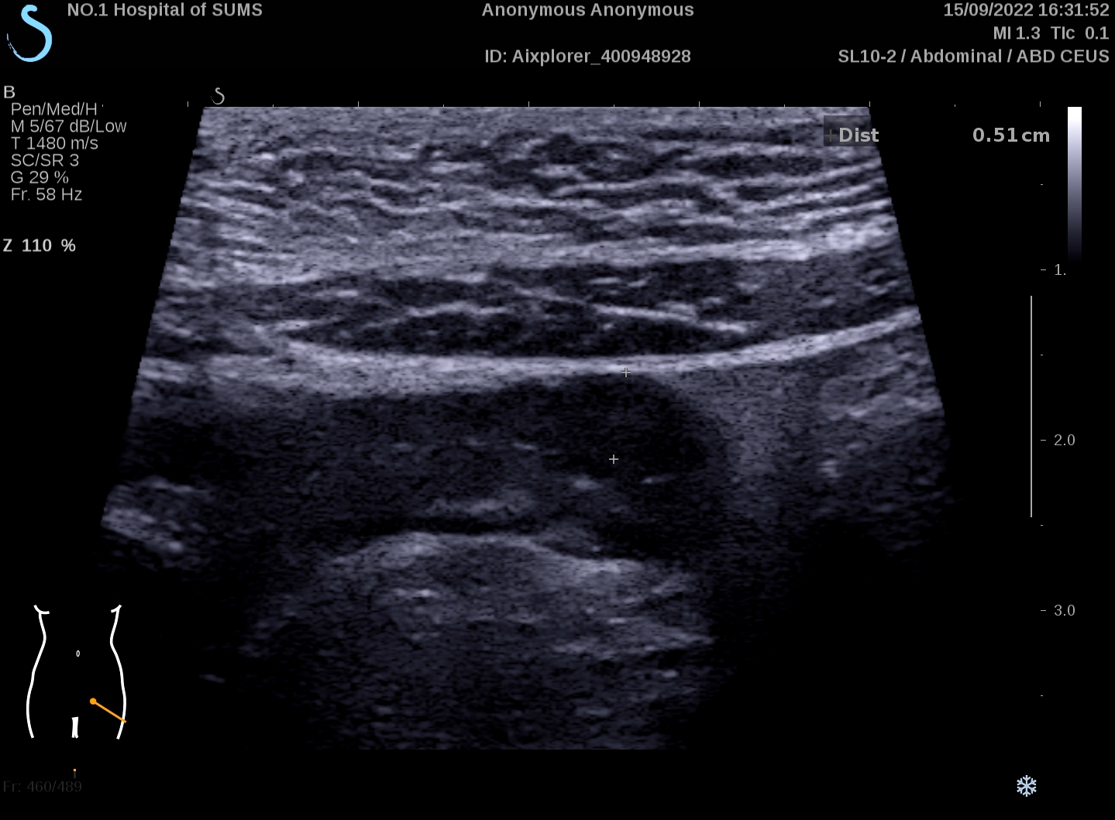
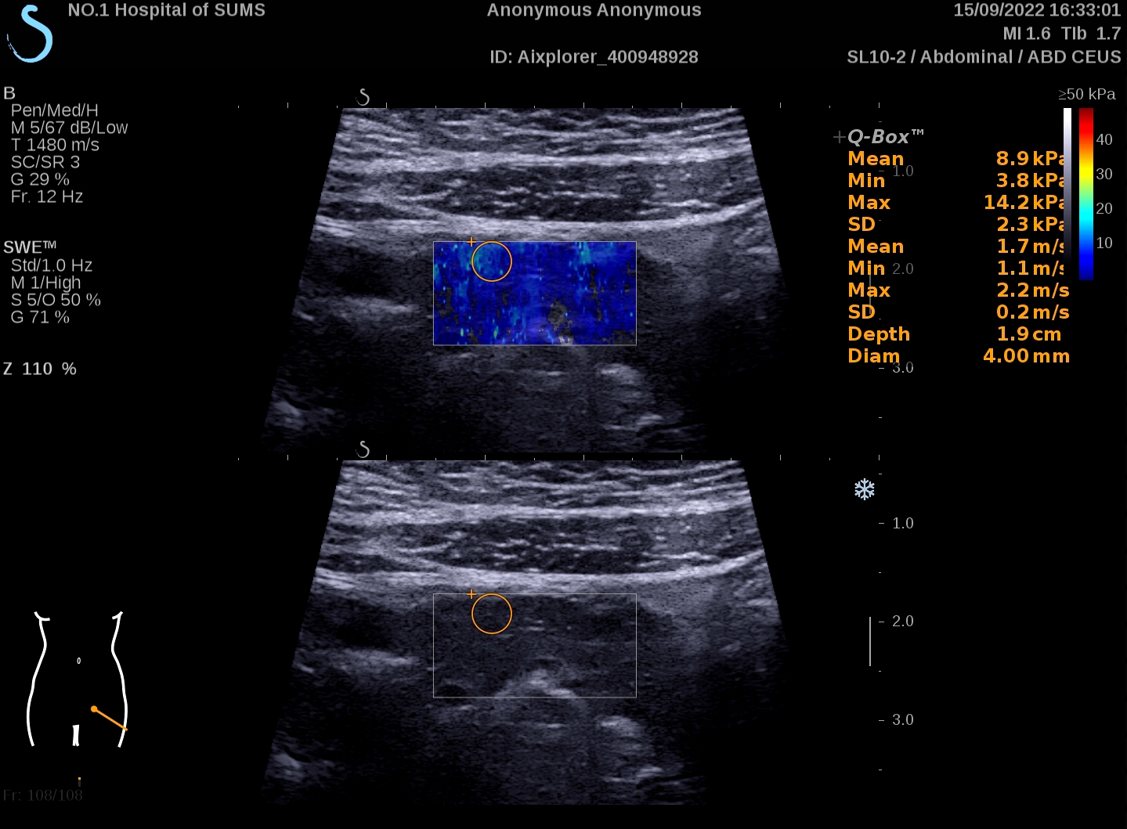

Role of Ultrasound Elastography (USE)
Elastography is an ultrasound-based technique that can measure tissue stiffness.¹
Poor standardization of the technique¹
Existence of different elastography modalities (strain ratio or shear wave) ¹
Measure can be subjected to the distance between bowel loops and ultrasonographic probes¹
Not yet fully validated^{2,3}
Clinical utility of USE in management of CD
USG can be used to evaluate the stiffness of pathological thickened bowel, as shown in the image on the left.⁴
Can measure fibrosis in patients with IBD.⁴
Image kindly provided by A/Prof. Ren Mao, First Affiliated Hospital of Sun Yat-sen University, China
USE has been proven to be able to assess intestinal fibrosis in patients with stricturing CD.⁵
USE: ultrasound elastography; CD: Crohn’s disease; IUS: intestinal ultrasound
1. Jauregui-Amezaga, A., & Rimola, J. (2021). Life (Basel, Switzerland), 11(7), 603. 2. Chen, Y. J., et al. (2018). Inflammatory bowel diseases, 24(10), 2183-2190. 3. Ślósarz, D., et al. (2021) Journal of Clinical Medicine, 10(18), 4044. 4.Nylund, K. (2017). Ultraschall in der Medizin (Stuttgart, Germany : 1980), 38(3), e1–e15. 5. Gabbiadini, R., et al. (2021) Current Drug Targets, 22(3), 347-355.
Notes:
Jauregui-Amezaga, A., & Rimola, J. (2021). Life (Basel, Switzerland), 11(7), 603.
Frias-Gomes, C., Torres, J., & Palmela, C. (2022). GE-Portuguese Journal of Gastroenterology, 29(4), 223-239.
Calabrese, E., et al. (2016) Inflammatory bowel diseases, 22(5), 1168-1183.
Chen, Y. J., et al. (2018). Inflammatory bowel diseases, 24(10), 2183-2190.
Ślósarz, D., et al. (2021) Journal of Clinical Medicine, 10(18), 4044.

Slide 10
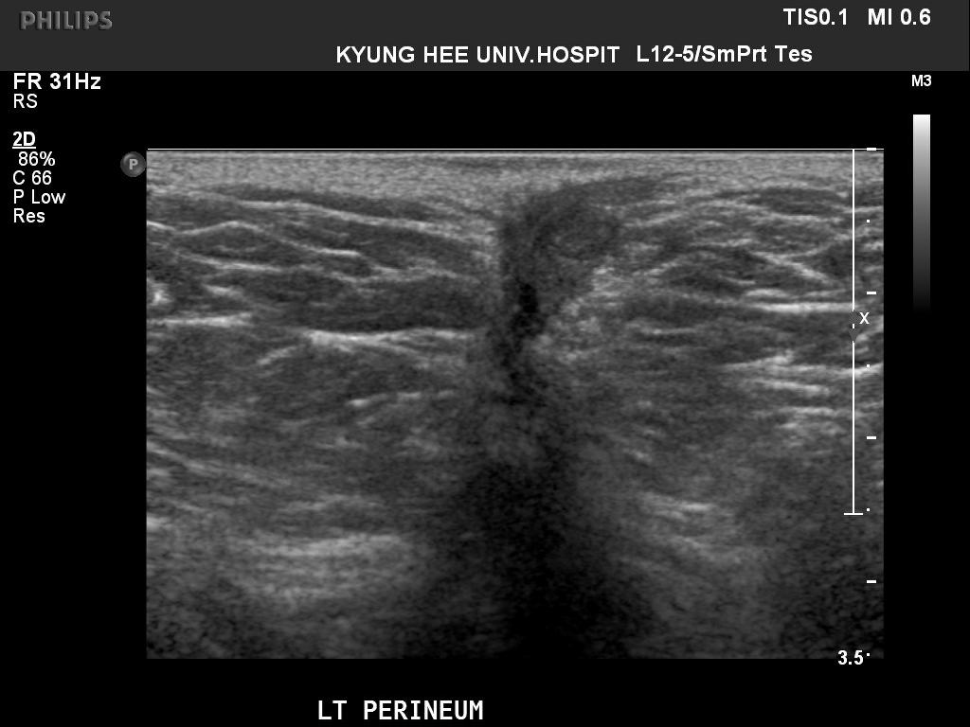
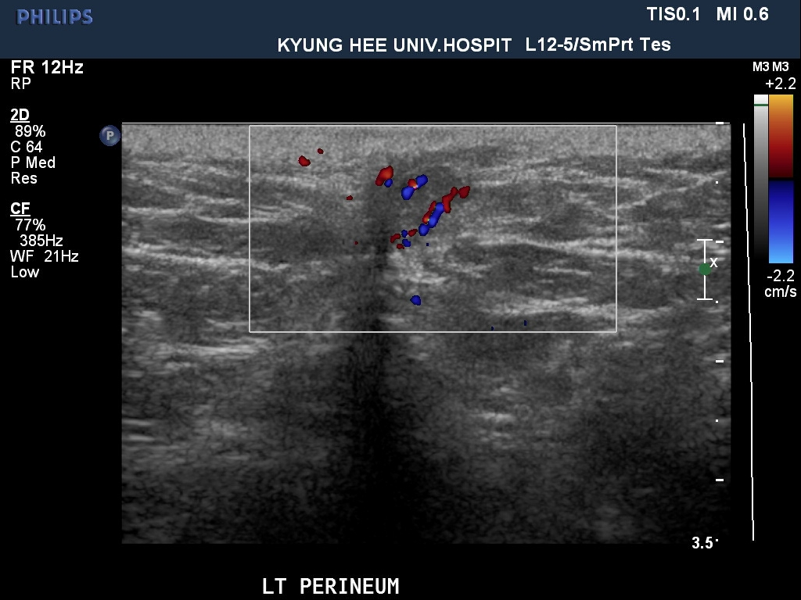
Role of Transperineal Ultrasonography (TPUS)
TPUS is a simple and painless ultrasound method to assess perianal disease.¹
Steep learning curve.¹
Clinical utility of TPUS in management of CD
TPUS showed a sensitivity of 90.6% and a positive predictive value (PPV) of 93.4% in detecting perianal fistulae when compared to pelvic MRI. ¹
TPUS showed a sensitivity of 50% and PPV of 79% for the detection of perineal abscesses. ¹
Perianal fistula on TPUS in a patient with CD
TPUS can be used to check disease activity in rectum.¹
Extrasphincteric and suprasphincteric fistulae are less detected by TPUS, when compared to transsphincteric and rectovaginal/ anovulvar fistulae.¹
Both images kindly provided by Prof. Chang Kyun Lee, Kyung Hee University, Korea
TPUS: transperineal ultrasonography; CD: Crohn’s disease; IUS: intestinal ultrasound; PPV: positive predictive value; MRI: magnetic resonance imaging
1. Frias-Gomes, C., Torres, J., & Palmela, C. (2022). GE-Portuguese Journal of Gastroenterology, 29(4), 223-239.
Notes:
1. Frias-Gomes, C., Torres, J., & Palmela, C. (2022). GE-Portuguese Journal of Gastroenterology, 29(4), 223-239.

